Slide 1















A practical introduction to Shell
X: angeomics

Slide 2
Set Up
Download the Git for windows Installer at https://gitforwindows.org/

Slide 3
Set Up
Install it and run wsl --install.
Reboot your computer Open Gitbash and run wsl --install again

Slide 4
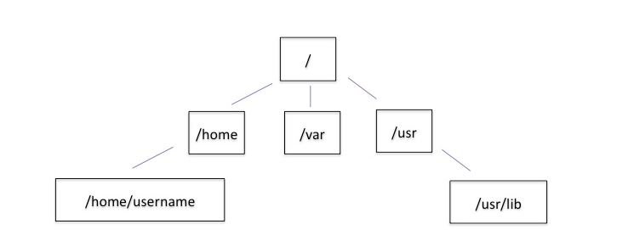
The Unix directory file structure (a.k.a. where am I?)

Slide 5
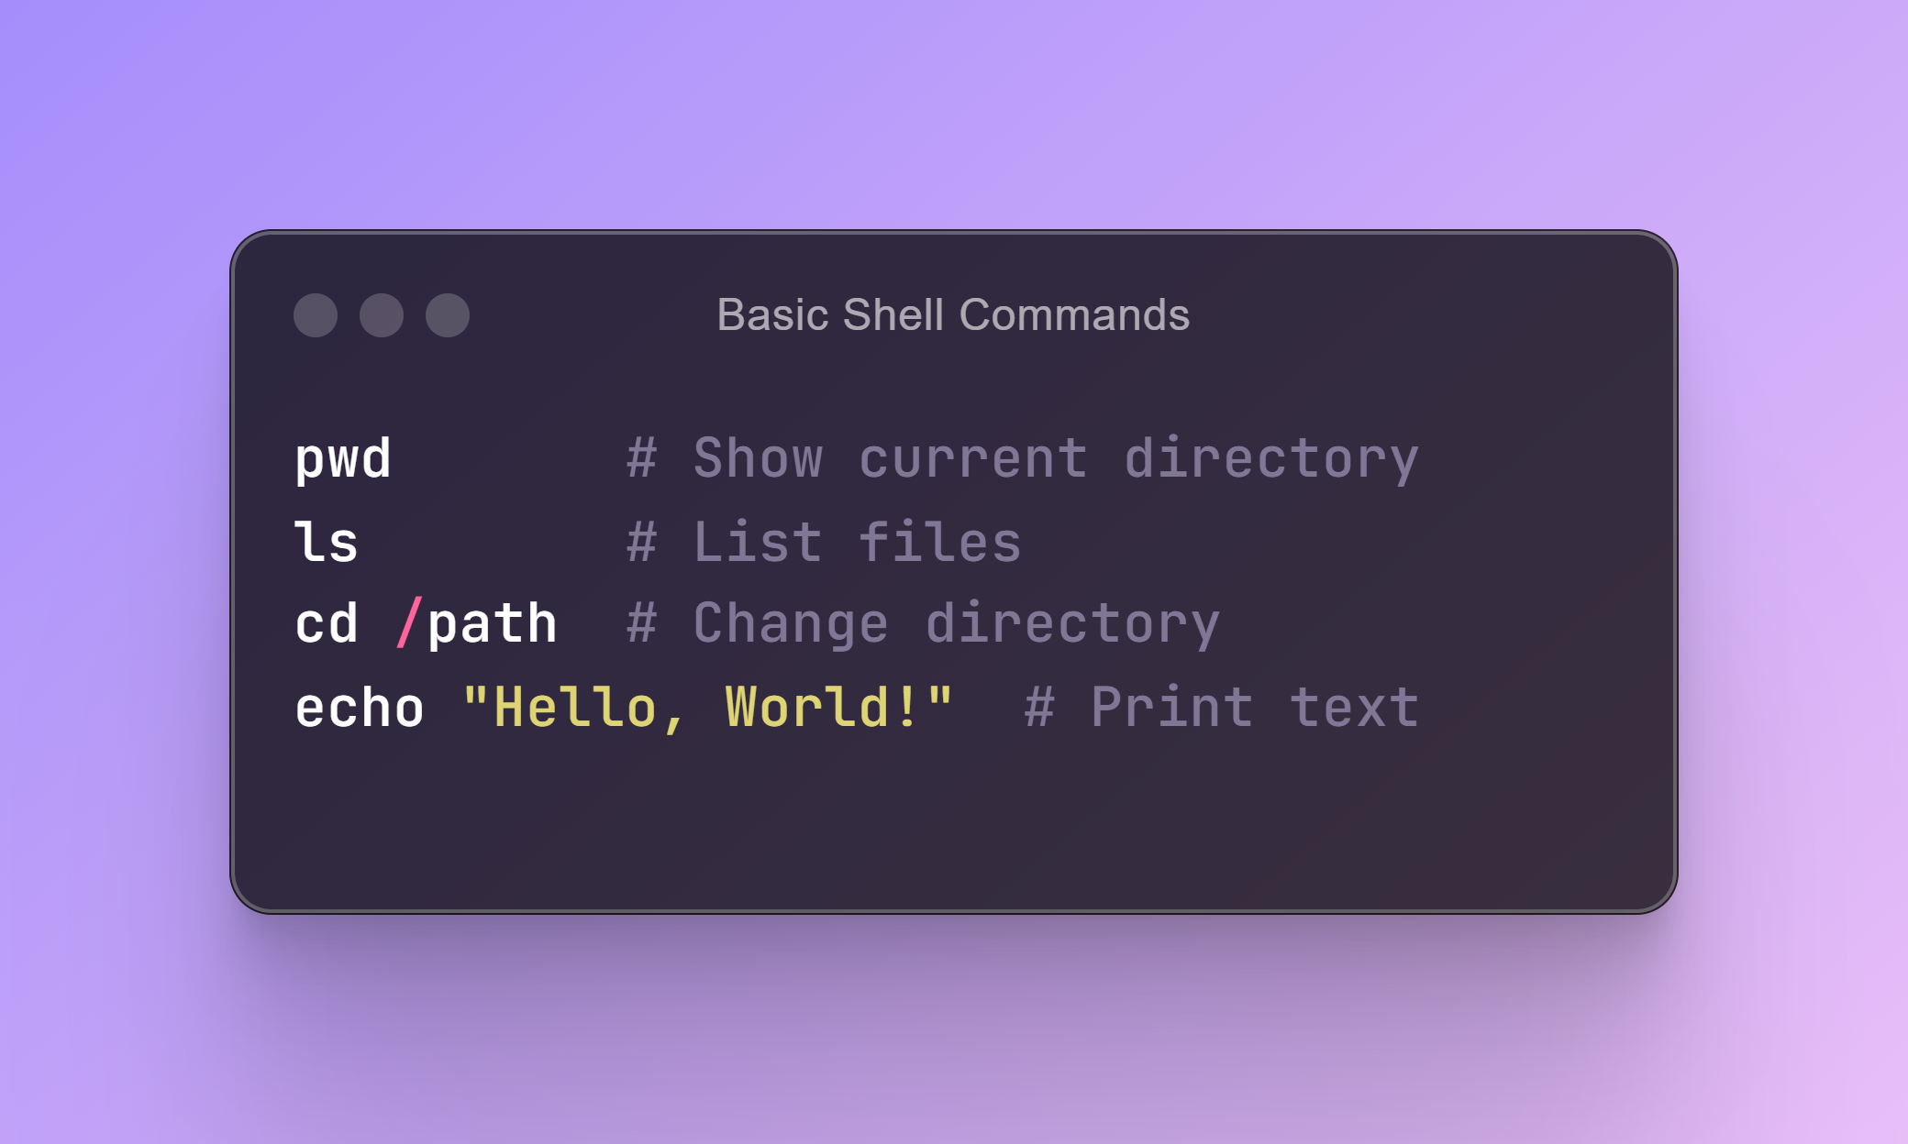
Purpose: Navigation and basic file operations

Slide 6
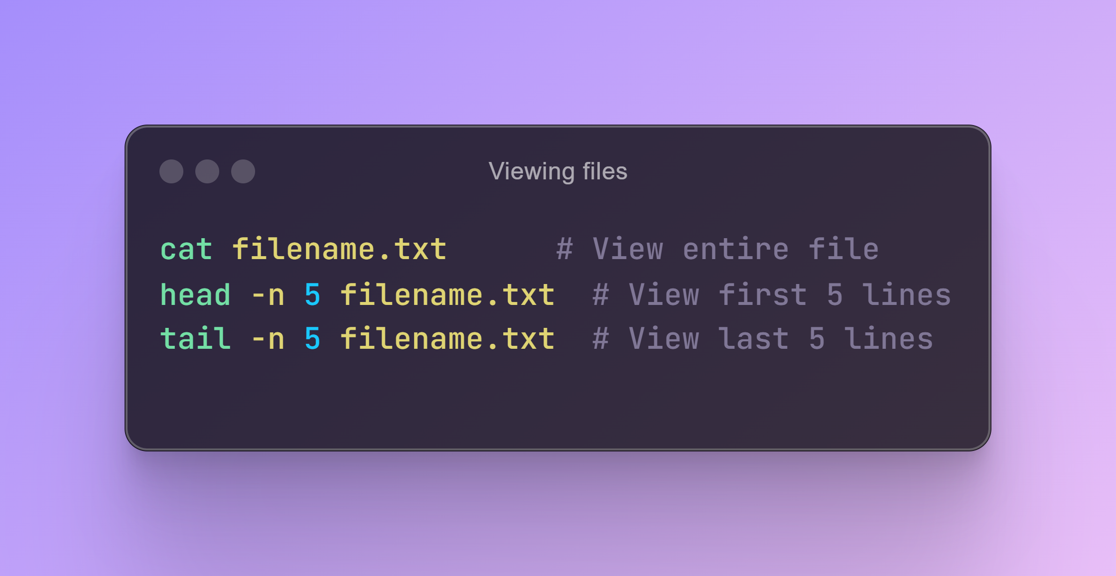

Slide 7
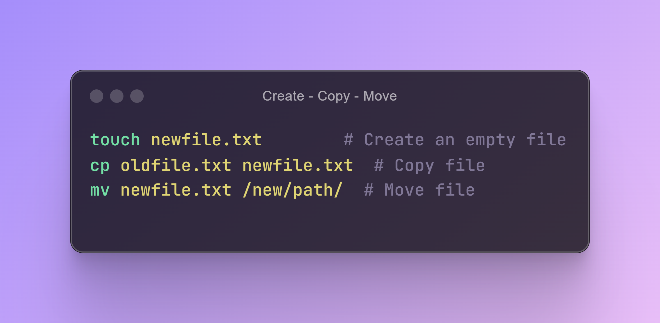

Slide 8
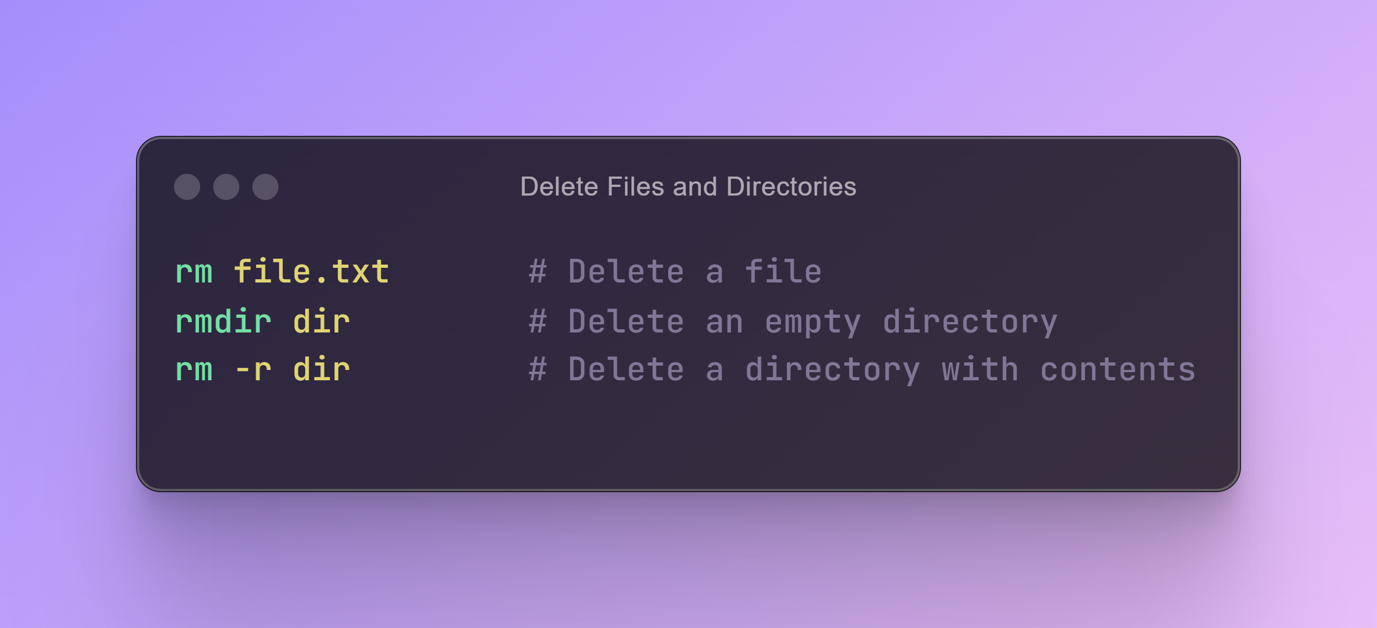

Slide 9
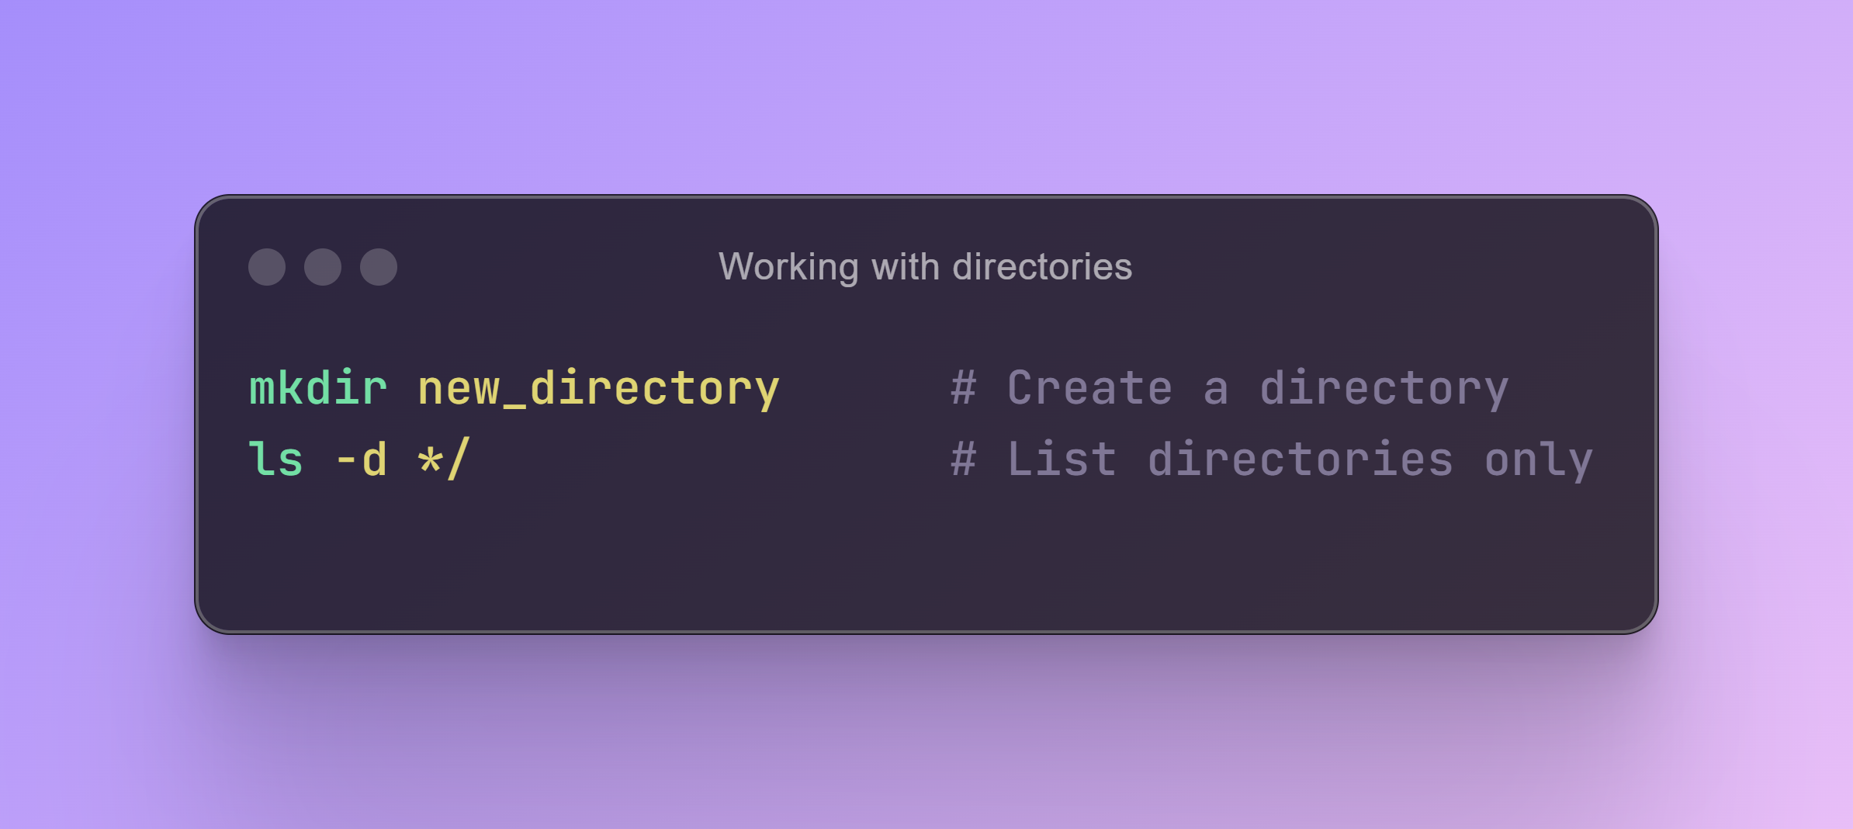

Slide 10
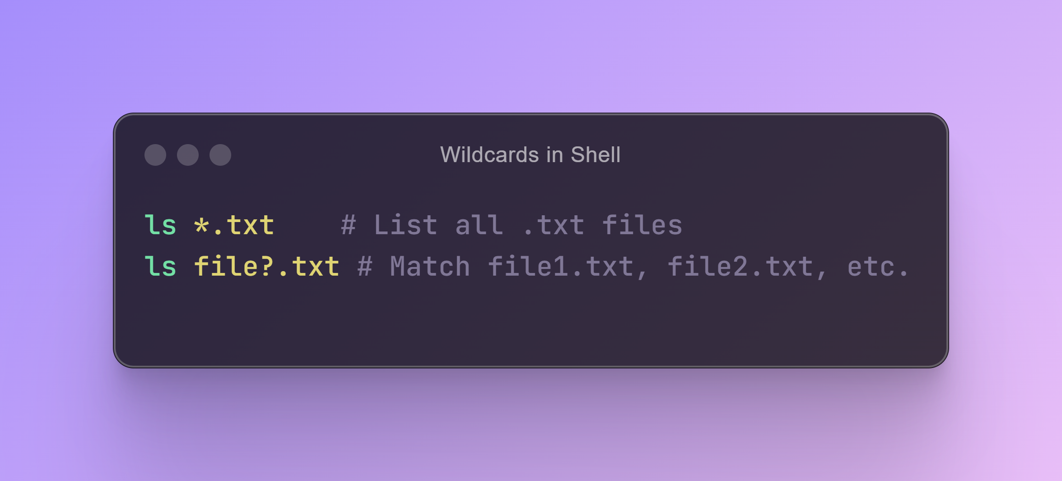

Slide 11
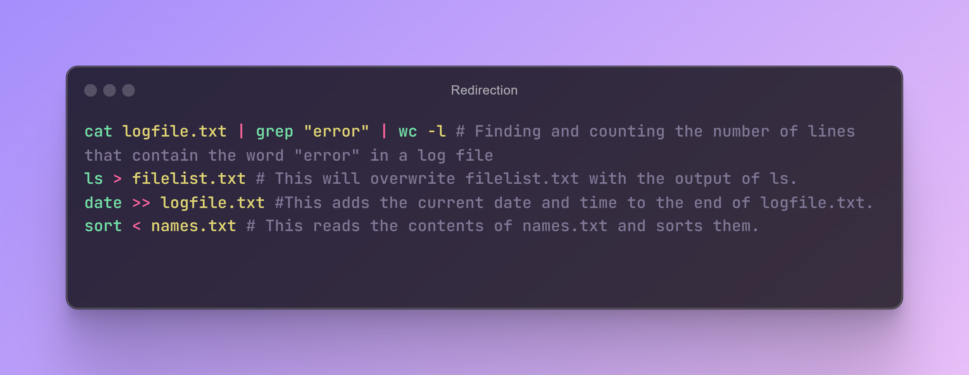

Slide 12
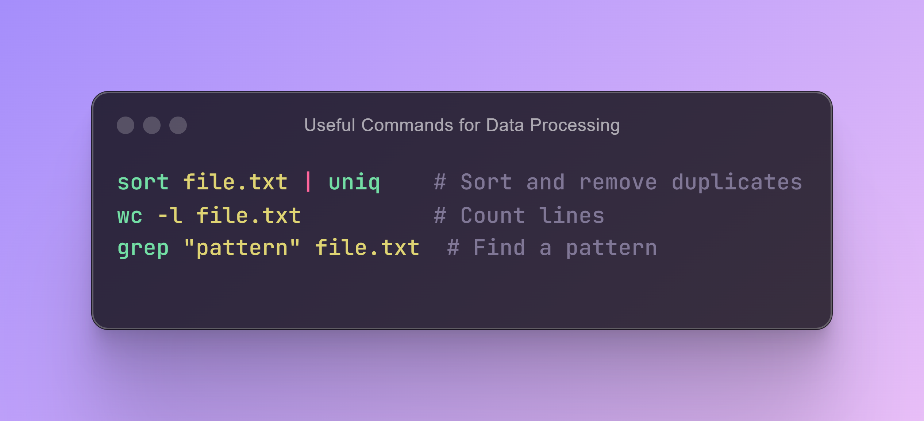

Slide 13
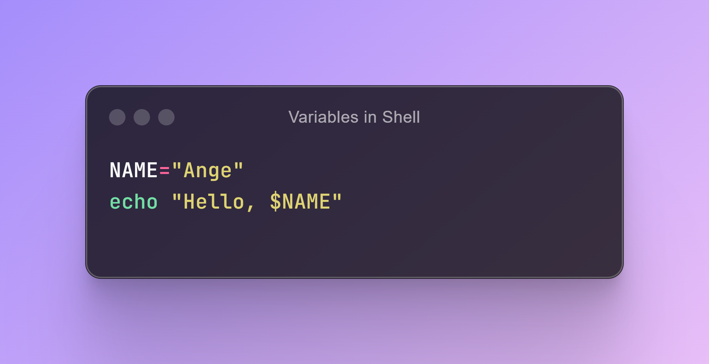

Slide 14
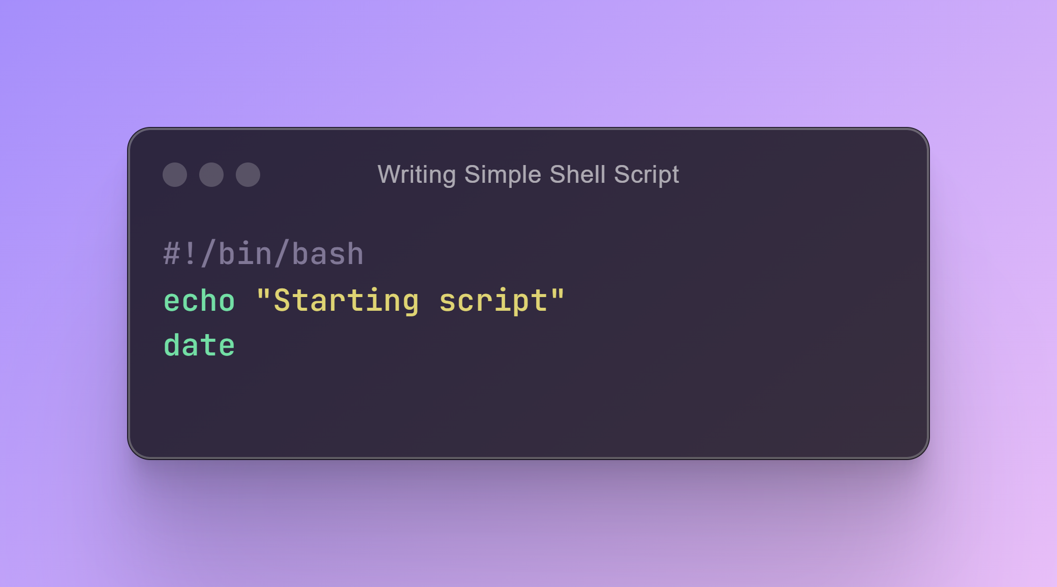

Slide 15
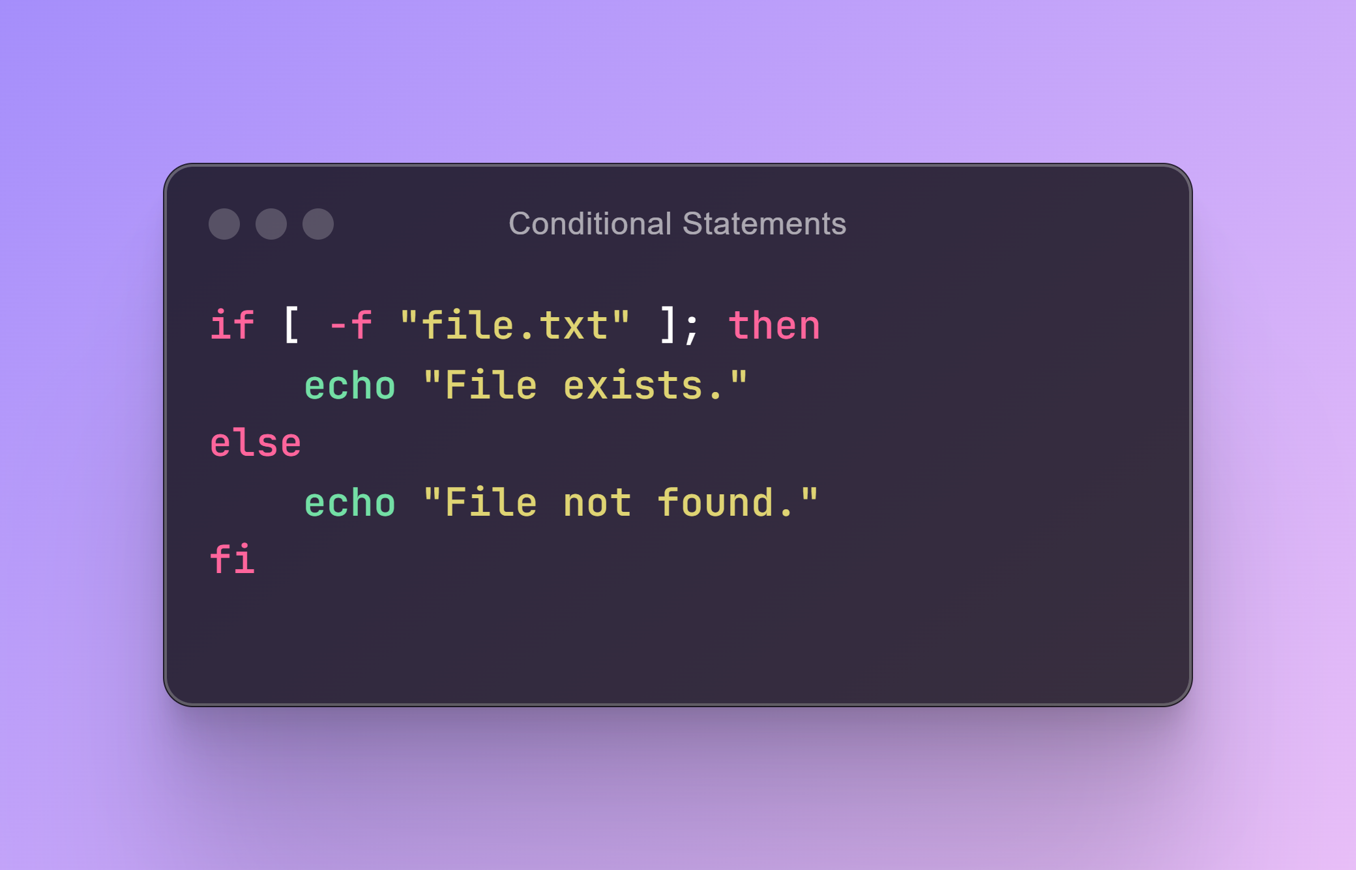

Slide 16
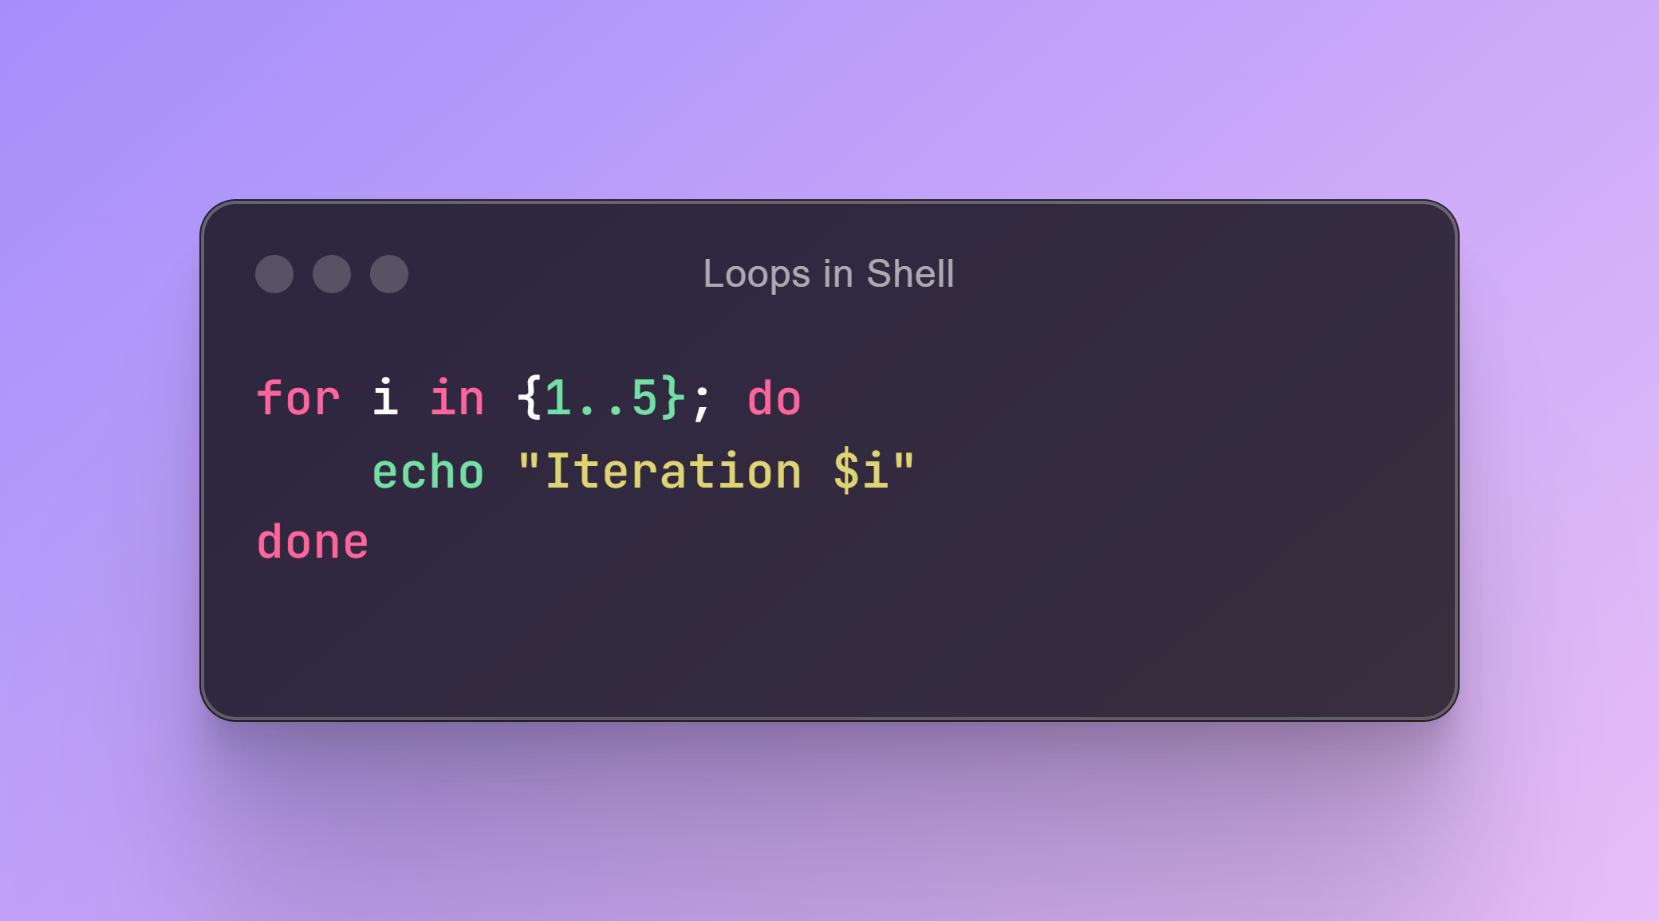

Slide 17
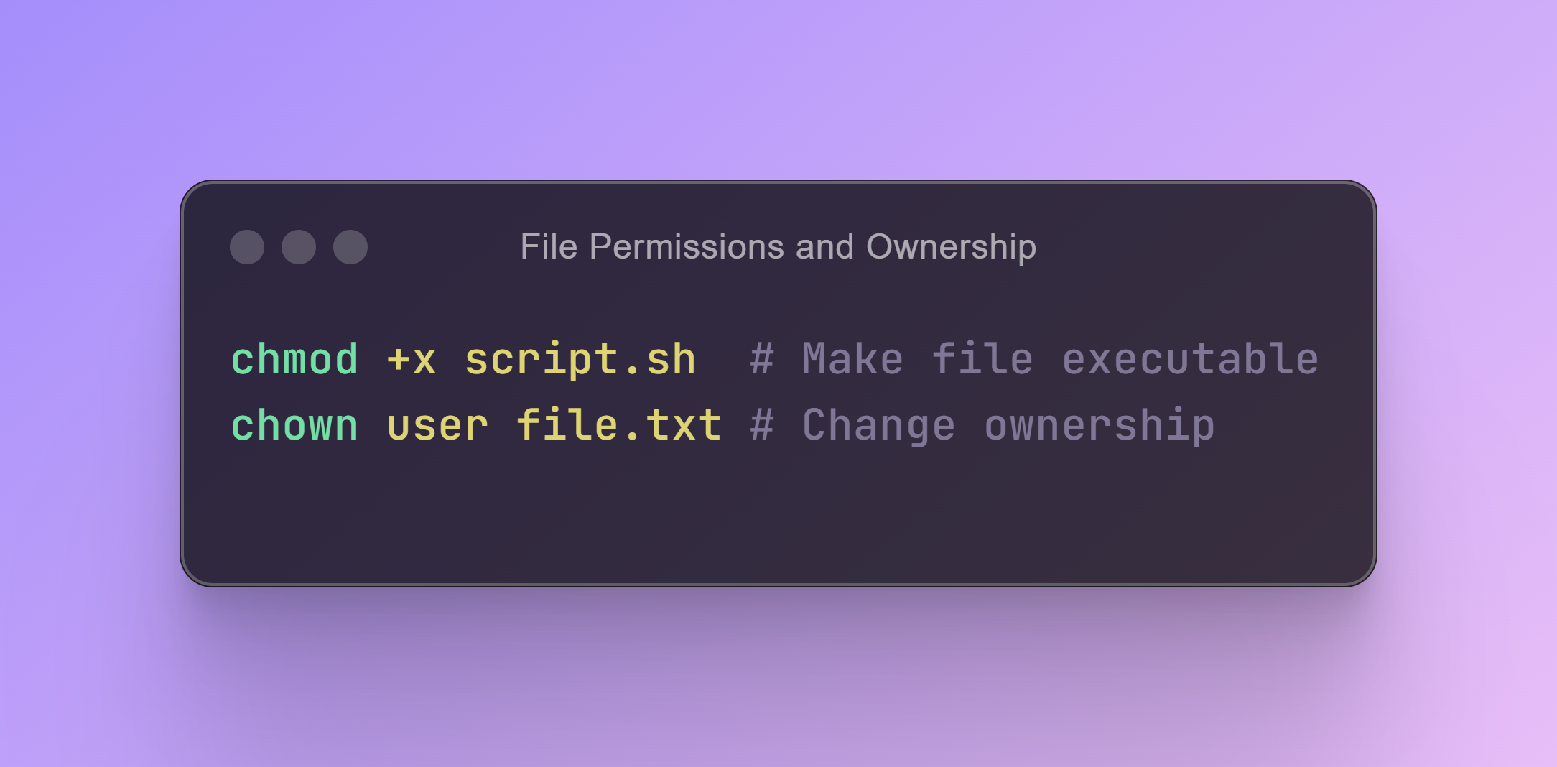

Slide 18
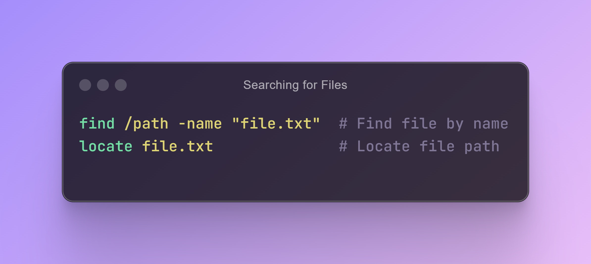

Slide 19
How to install miniconda3 ?
# download latest conda installer
$ wget https://repo.continuum.io/miniconda/Miniconda3-latest-Linux-x86_64.sh
# run the installer
$ bash Miniconda3-latest-Linux-x86_64.sh

Slide 20
How to install miniconda3
# Install some conda channels
# A channel is where conda looks for packages
$ conda config --add channels defaults
$ conda config --add channels bioconda
$ conda config --add channels conda-forge

Slide 21
How to install bioinformatics tools via conda?
# activate your conda base
$ source /full/path/to/miniconda3/bin/activate
# Create an environment specific to your tool(fastqc, fastp, multiqc, hisat2, samtools, subread)
$ conda create --name fastqc_env
# Install your tool
$ conda install –c bioconda fastqc

Slide 22
How to install bioinformatics tools via conda?
# Check if your tool is well installed
$ fastqc --help
# Exit the environment
$ conda deactivate
# Install your tool
$ conda install –c bioconda fastqc

Slide 23
Thank
You

